Slide 1

Full stack monitoring across networks with Azure Monitor
@AzureMonitor

Slide 2

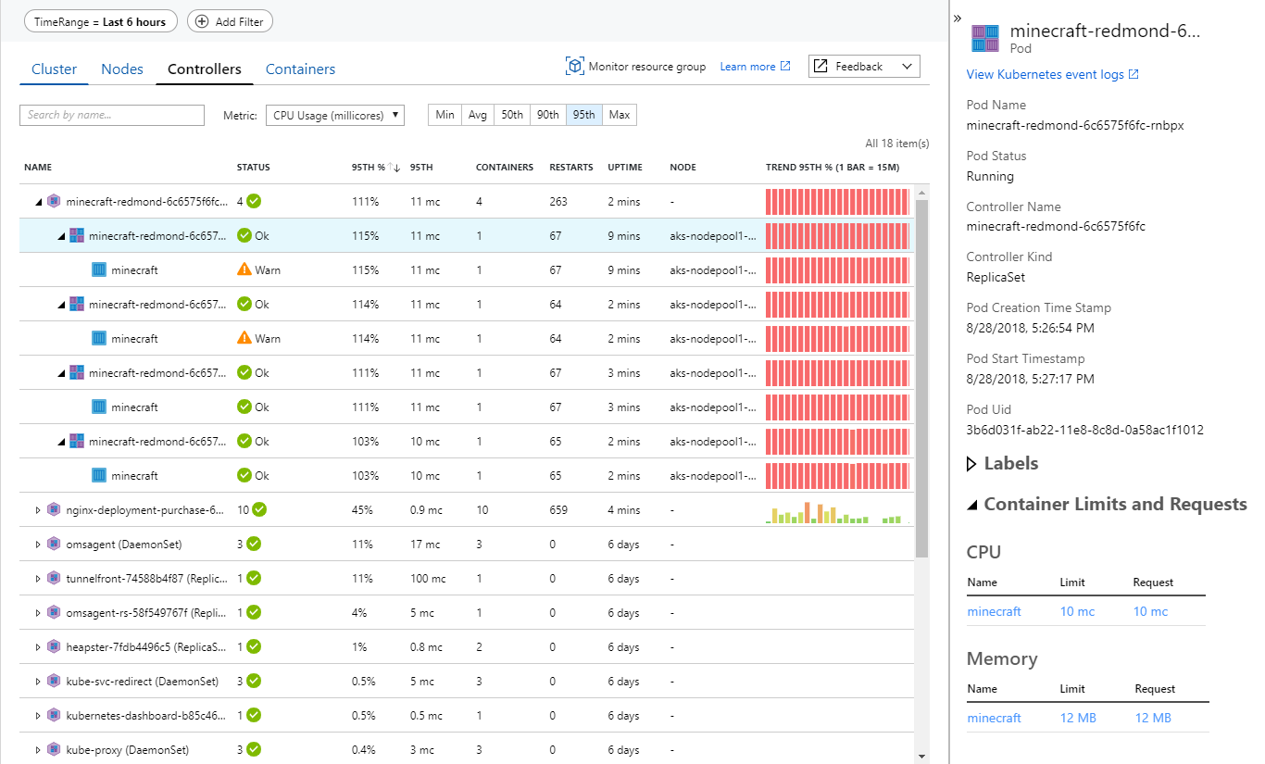
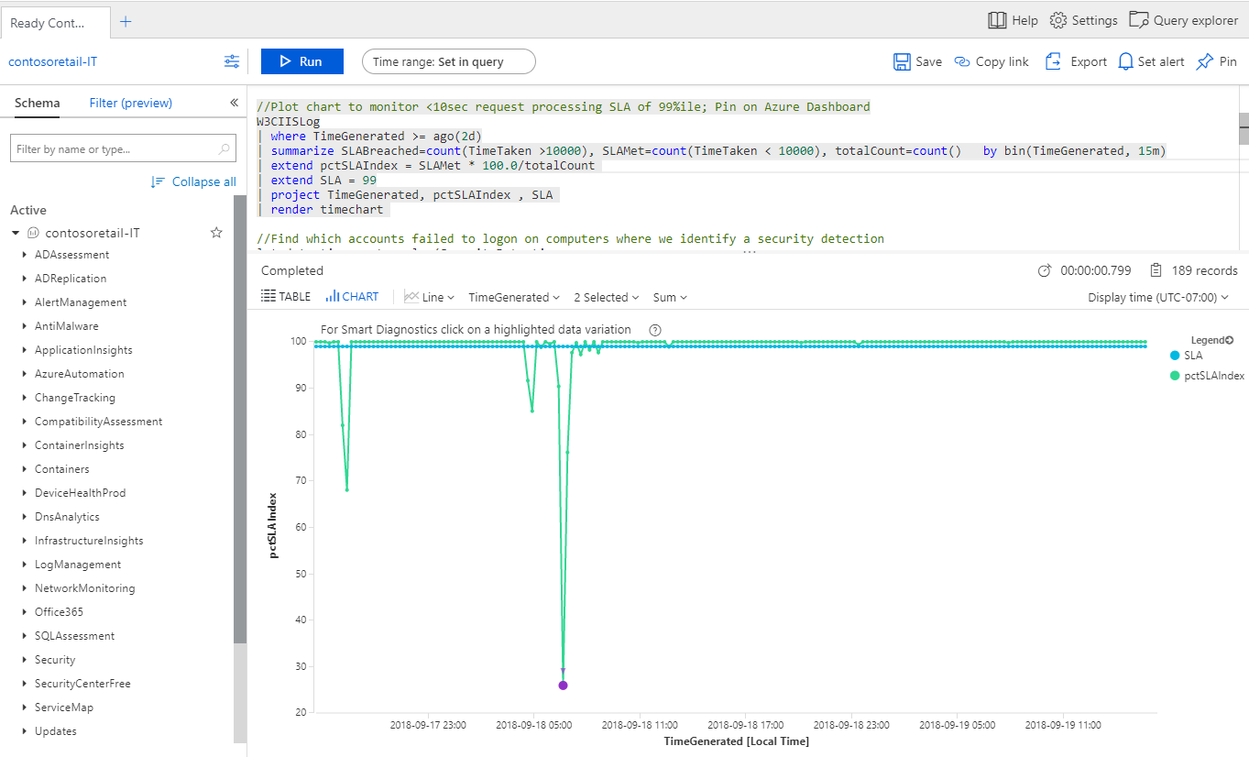
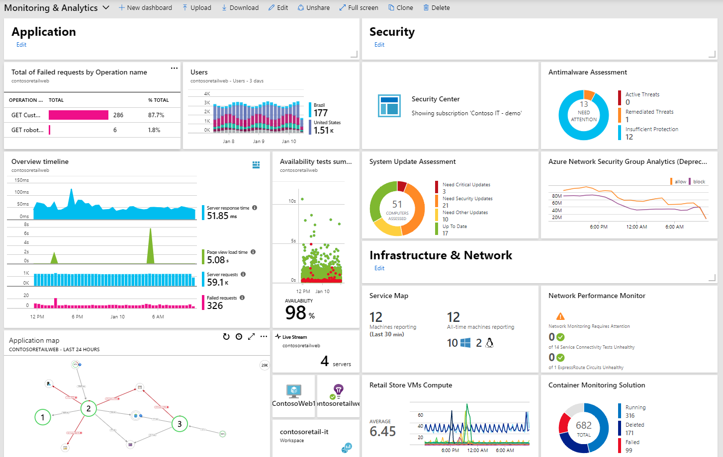
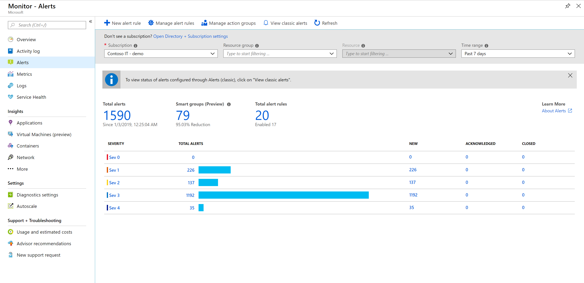
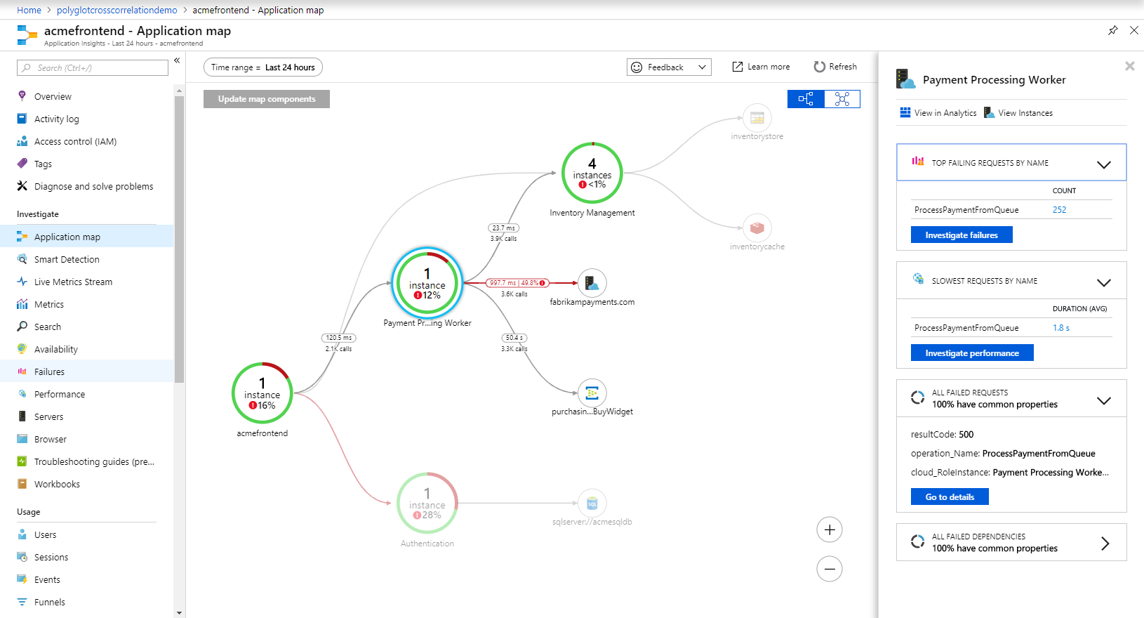
Azure Monitor Overview (Azure / Hybrid)
Detect & diagnose issues across apps and dependencies with App Insights
Correlate issues at infra level with Azure Monitor for VM, AKS, Storage, Network
Operationalize at scale with Smart Alerts & Automated Actions
Drill down with Log Analytics for troubleshooting & deeper diagnostics
Create visualizations with Azure Dashboards & Workbooks

Slide 3










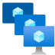




Azure Monitor
Conceptual Architecture
Insights
Application
Container
VM
Network
Visualize
Application
Dashboards
Power BI
Workbooks
Metrics
Infrastructure
Collect
Analyze
Azure Platform
Metrics Explorer
Log Analytics
Logs
Custom Sources
Respond
Alerts
Action Groups
Autoscale
Integrate
Event Hubs
Logic Apps
Ingest & Export APIs
Notes:
So how does Azure Monitor work.
1) It all starts with collecting telemetry. Azure Monitor can collect data from Application, Network, Infrastructure and you can also ingest your own custom data. All the data is stored in centralized, fully managed logs and metrics stores. So what can you do with all the data:
Typically you start with insights which are end to end experiences we have put together for canonical scenarios or resources such as applications, containers, VMs, network, storage etc. Insights provide guidance and help troubleshoot and root cause issues quickly with a drill down experience.
You may in certain cases, just want to visualize the data. For that we provide Azure dashboards, Power BI integrations and a more native experience called Workbooks.
After visualizing the data, you may form some hypothesis and want to test them out. For that you need access to the raw data stores. For that we provide metrics explorer and a powerful big data platform called Log Analytics that is capable of querying petabytes of data within seconds.
If you want to pro-active and take corrective actions, you can create alerts and runbooks to auto remedy an issue. Or if it’s a capacity issue, you can choose to scale-in or scale-out
Finally, we know that monitoring isn’t done is silos. Azure Monitor provides out of the box integration with popular ITSM and DevOps tools. You can again use APIs, EventHub and Logic Apps to build custom integrations.

Slide 4
Data Collection & Onboarding
Application
Application Insights SDK/Agent
Multi-Language Support
Azure Monitor
Infrastructure
Agents
Windows + Linux Support
Workload Agnostic
Metrics
Azure Resources
Azure Subscription
Zero Instrumentation
Logs & Metrics
Logs
Azure Tenant
Custom Sources
REST APIs
Notes:
It all starts with collecting telemetry. Depending on the type of resource, Azure Monitor will provide a corresponding way to collect telemetry. For application performance monitoring – ie. for telemetry such as page load time, dependency tracing etc. you can install the Application Insights SDK. For certain supported programming languages such as ASP.NET, you can just install an agent on the web server and we can collect the telemetry for you without even touching the code..
For capturing operating system data such as syslog, you can install a Windows/Linux agent.
We talked about an integrated monitoring system. That becomes evident for Azure resources, or subscription or tenant – you can get all the telemetry from anything Azure directly without any instrumentation!
Finally, you always have your own custom telemetry that you may want to inject. For example, this may be an SAP workload and you may want to inject some business telemetry – you can do that with our injection APIs.
Once you have it all configured, you can see all the data in centralized, fully managed metrics and logs stores.

Slide 5
Ensuring monitoring at scale
Configuration
Deploy Log Analytics Agent & enable Diagnostic Settings via ARM Templates, Azure CLI, PowerShell or Azure Automation DSC
Integrate monitoring as part of CI/CD workflows (Azure Pipelines/Azure DevOps Projects/Terraform)
Management
Enable out-of-the-box Azure Policy Initiatives for Azure Monitor (VM Insights & Diagnostic Settings)
Leverage Management Groups to prevent monitoring blind spots
Manage multiple tenants via Azure Lighthouse
Visualization
Customize Workbooks for aggregated reports across resources
Build diagnostic or KPI Dashboards in Azure, Power BI or Grafana
Operationalization
Setup Multi-resource Alerts that grow flexibly with your resources
Use Dynamic Thresholds to enable scalable ML powered alerts for metrics
Use Action Rules to manage Alert Suppression & Actions at scale

Slide 6
Diagnosing network issues across the stack
1
2
Network Dependency Logs (Connections, Ports, Traffic, Security)
Client-side Network Metrics (Page Load Network Connect Time)
VM/Server Layer
Application Layer
Azure Monitor (Application Insights)
Azure Monitor (VM Insights)*
Service Connectivity Monitor
Network Performance Monitor
On-Premises Network
Network Resource Health
Network Topology & Connection Monitor
NSG Flow Logs & Traffic Analytics
Azure Cloud Network
ExpressRoute Monitor
Azure Monitor (Network Insights)*
Network Performance Monitor Solution
Azure Network Watcher
3
Cross App/Infra Logs Correlation
Azure Monitor (Log Analytics)
*Service in Preview
Notes:
You need not always be a Network Engineer to be cognizant of Network Issues impacting your systems environment.
Network Watcher is a cloud-based solution for troubleshooting and monitoring networks in Azure. Use it to:
Troubleshoot and localize connectivity issues.
Perform packet captures to detect application behavior.
Check configuration (for example, routing) issues in complex topology environments.
Audit your networks with network security group flow logs and Traffic Analytics (see available regions).
Monitor network connectivity within the cloud and across hybrid environments using Azure Connection Monitor and Azure Network Performance Monitor.

Slide 7
Using Agents & Extensions for VMs & Servers
Log Analytics Agent - Collect data from Guest OS & VM Workloads in LA workspaces. Same agent as used by SCOM (which can be multi-homed) and also referred to as MMA/OMS Agent. Required for writing Log Analytics Queries or using VM Insights, Azure Security Center or Azure Sentinel.
Dependency Agent – Collect discovered data about running processes & external process dependencies on VMs. Required for VM Insights Maps feature and has dependency on Log Analytics Agent.
InfluxData Telegraf Agent – Collect performance data from Linux VMs to Azure Monitor metrics. Required for Metrics Alerts & Autoscale (Linux).
Azure Diagnostics Extension – Collect data from Guest OS & Compute Workloads in Azure in Storage/Event Hubs or Azure Monitor metrics. Required for Metrics Alerts & Autoscale (Windows) and for VM Boot Diagnostics.
Network Watcher Agent – Network performance monitoring, diagnostic, and analytics service that allows monitoring for Azure networks
Windows VM/Server
Linux VM/Server
 | Azure Diagnostics Extension (WAD) | Log Analytics Agent | Dependency Agent
Environments Supported | Azure | Azure Other cloud On-premises | Azure Other cloud On-premises
Agent Requirements | None | None | Requires Log Analytics agent
Data Collected | Event Logs ETW events Performance File based logs IIS logs .NET app logs Crash dumps Agent diagnostics logs | Event Logs Performance File based logs Insights and solutions Other services | Process details and dependencies Network connection metrics
Data Sent To | Azure Storage Azure Monitor Metrics Event Hub | Azure Monitor Logs | Azure Monitor Logs
 | Diagnostics Extension (LAD) | Telegraf Agent | Log Analytics Agent | Dependency Agent
Environments Supported | Azure | Azure Other cloud On-premises | Azure Other cloud On-premises | Azure Other cloud On-premises
Agent Requirements | None | None | None | Requires Log Analytics agent
Data Collected | Syslog Performance | Performance | Syslog Performance Security Custom logs Container logs Insights and solutions Other services | Process details and dependencies Network connection metrics
Data Sent To | Azure Storage Event Hub | Azure Monitor Metrics | Azure Monitor Logs | Azure Monitor Logs
Notes:
https://docs.microsoft.com/en-us/azure/azure-monitor/platform/agents-overview

Slide 8
Azure Monitor Diagnostic Settings
Azure resources
Logic apps
Network security groups
Key vaults
Log Analytics
…etc.
Storage account
Azure subscriptions
Azure Monitor Diagnostic Settings
Resource manager
Event Hub
Service health
Autoscale engine
…etc.
Azure, On-premises, other clouds
Splunk, QRadar, Elastic, etc
Azure (AD) tenants
Azure Active Directory
Intune

Slide 9

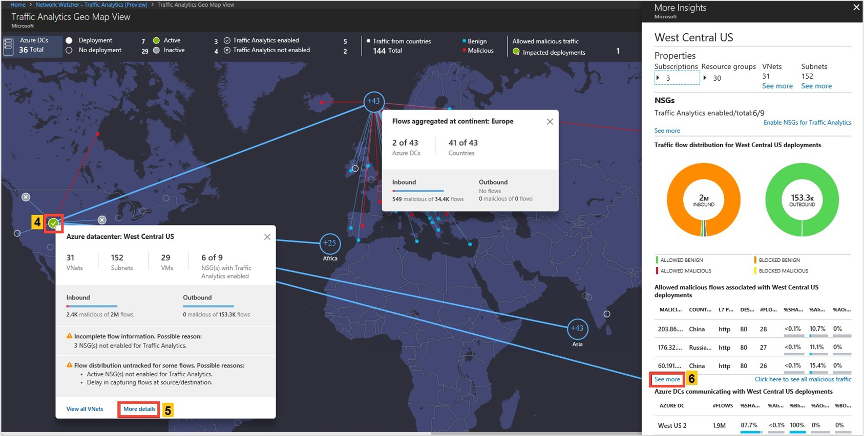
Monitor Network Health & Traffic
Secure and audit your network with Network Watcher Traffic Analytics
Discover and monitor ExpressRoute circuits, across subscriptions
Monitor ExpressRoute connectivity to virtual networks and O365
Monitor connectivity to LoB apps with Service Connectivity Monitor
Notes:
Azure provides network troubleshooting and monitoring capabilities
Our solutions can monitor networks In Azure, hybrid and on-premises networks
We have released several new monitoring capabilities, since previous Ignite:
Traffic Analytics - Network Watcher enables the generation of traffic flow logs corresponding to Network Security Groups set up by customers. These flow logs are used as the basis by the Traffic Analytics solution to visualize traffic flow characteristics into/out of customers’ virtual networks, correlated with other information such as malicious IP. TA gives insights for capacity planning, traffic flow audit and identifying anomalies.
NPM can now monitor ExpressRoute circuits and connectivity to SaaS and LoB applications
ExpressRoute - ExpressRoute is a key connectivity solution offered to connect customer premises with Azure using high-bandwidth private connectivity. Customers can monitor the characteristics of their ER connections including loss/latency/bandwidth utilization as well as topology details and usage of primary and secondary ER connections.
Service Connectivity Monitor - Customers can also monitor connectivity to cloud services, such as O365 and Salesforce.
All of the above solutions are generally available.
Network Watcher is a cloud-based solution for troubleshooting and monitoring networks in Azure. Use it to:
Troubleshoot and localize connectivity issues.
Perform packet captures to detect application behavior.
Check configuration (for example, routing) issues in complex topology environments.
Audit your networks with network security group flow logs and Traffic Analytics (see available regions).
Monitor network connectivity within the cloud and across hybrid environments using Azure Connection Monitor and Azure Network Performance Monitor.

Slide 10
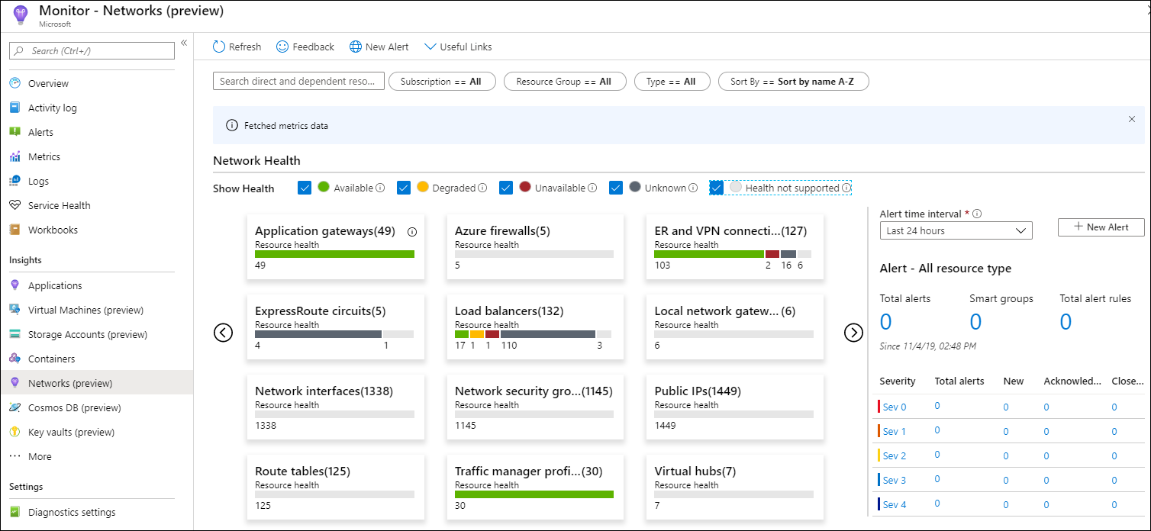
Azure Monitor for Networks (Preview)
Comprehensive view of health and metrics for all deployed resources
No external resource configuration required
Advanced search capability helps identify resource dependencies
Search & filtering, Resource Health & Metrics, Alerts, Dependency view
Notes:
Azure provides network troubleshooting and monitoring capabilities
Our solutions can monitor networks In Azure, hybrid and on-premises networks
We have released several new monitoring capabilities, since previous Ignite:
Traffic Analytics - Network Watcher enables the generation of traffic flow logs corresponding to Network Security Groups set up by customers. These flow logs are used as the basis by the Traffic Analytics solution to visualize traffic flow characteristics into/out of customers’ virtual networks, correlated with other information such as malicious IP. TA gives insights for capacity planning, traffic flow audit and identifying anomalies.
NPM can now monitor ExpressRoute circuits and connectivity to SaaS and LoB applications
ExpressRoute - ExpressRoute is a key connectivity solution offered to connect customer premises with Azure using high-bandwidth private connectivity. Customers can monitor the characteristics of their ER connections including loss/latency/bandwidth utilization as well as topology details and usage of primary and secondary ER connections.
Service Connectivity Monitor - Customers can also monitor connectivity to cloud services, such as O365 and Salesforce.
All of the above solutions are generally available.
Network Watcher is a cloud-based solution for troubleshooting and monitoring networks in Azure. Use it to:
Troubleshoot and localize connectivity issues.
Perform packet captures to detect application behavior.
Check configuration (for example, routing) issues in complex topology environments.
Audit your networks with network security group flow logs and Traffic Analytics (see available regions).
Monitor network connectivity within the cloud and across hybrid environments using Azure Connection Monitor and Azure Network Performance Monitor.

Slide 11
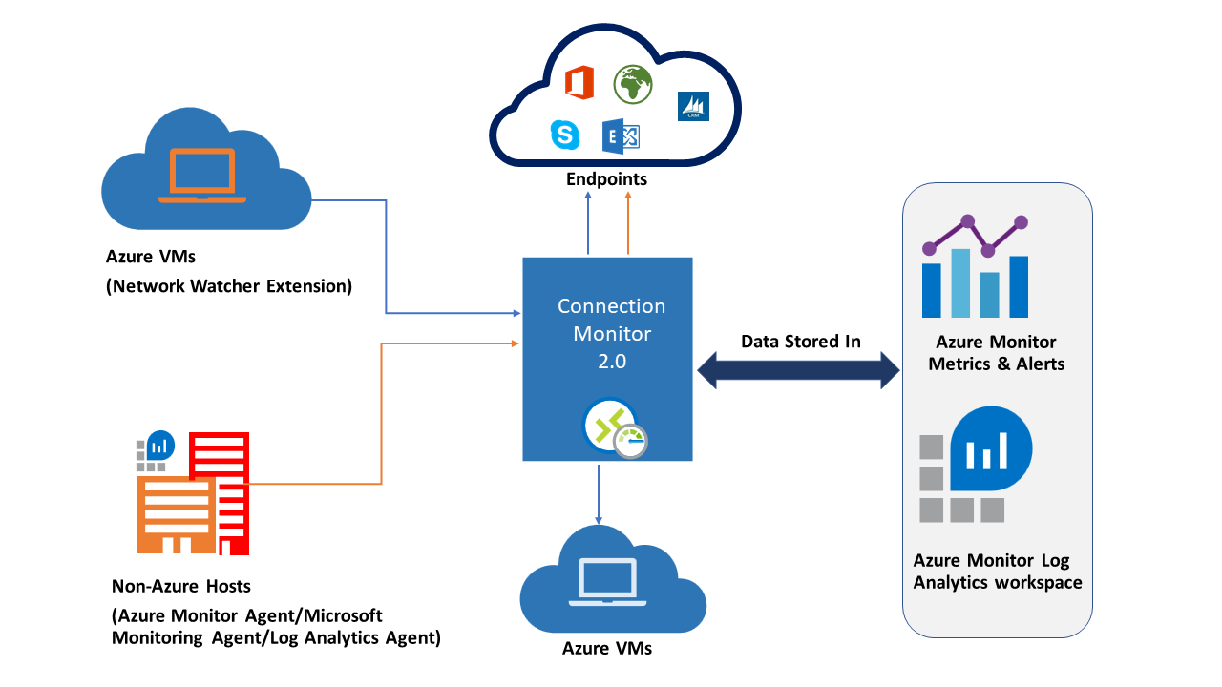
Connection Monitor 2.0 (Preview)
Notes:
Azure provides network troubleshooting and monitoring capabilities
Our solutions can monitor networks In Azure, hybrid and on-premises networks
We have released several new monitoring capabilities, since previous Ignite:
Traffic Analytics - Network Watcher enables the generation of traffic flow logs corresponding to Network Security Groups set up by customers. These flow logs are used as the basis by the Traffic Analytics solution to visualize traffic flow characteristics into/out of customers’ virtual networks, correlated with other information such as malicious IP. TA gives insights for capacity planning, traffic flow audit and identifying anomalies.
NPM can now monitor ExpressRoute circuits and connectivity to SaaS and LoB applications
ExpressRoute - ExpressRoute is a key connectivity solution offered to connect customer premises with Azure using high-bandwidth private connectivity. Customers can monitor the characteristics of their ER connections including loss/latency/bandwidth utilization as well as topology details and usage of primary and secondary ER connections.
Service Connectivity Monitor - Customers can also monitor connectivity to cloud services, such as O365 and Salesforce.
All of the above solutions are generally available.
Network Watcher is a cloud-based solution for troubleshooting and monitoring networks in Azure. Use it to:
Troubleshoot and localize connectivity issues.
Perform packet captures to detect application behavior.
Check configuration (for example, routing) issues in complex topology environments.
Audit your networks with network security group flow logs and Traffic Analytics (see available regions).
Monitor network connectivity within the cloud and across hybrid environments using Azure Connection Monitor and Azure Network Performance Monitor.

Slide 12
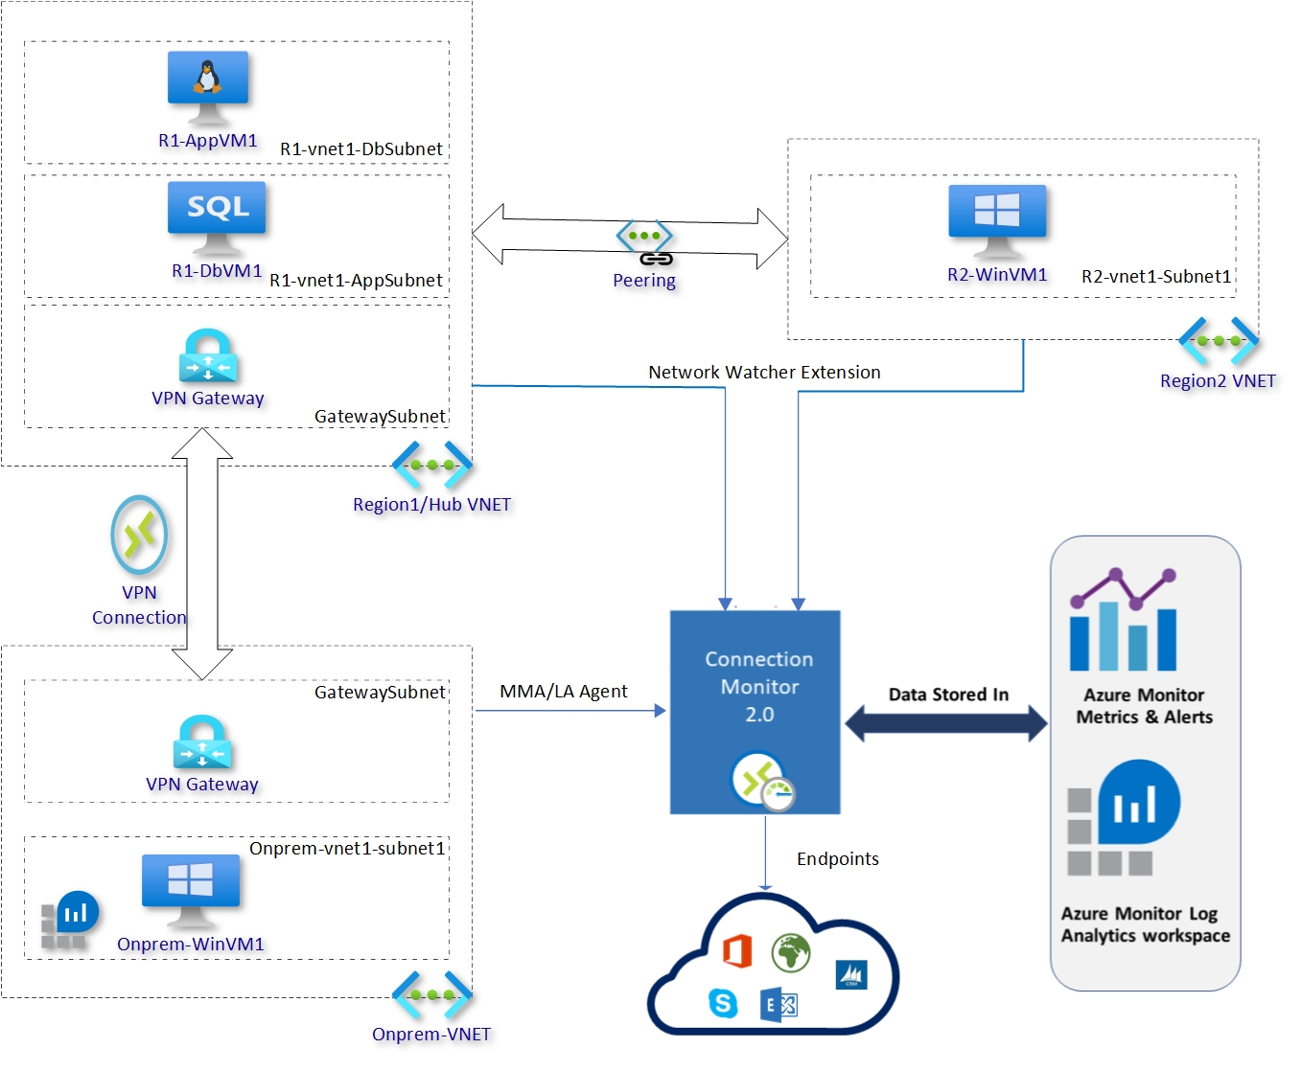
Connection Monitor – Demo environment
Notes:
Azure provides network troubleshooting and monitoring capabilities
Our solutions can monitor networks In Azure, hybrid and on-premises networks
We have released several new monitoring capabilities, since previous Ignite:
Traffic Analytics - Network Watcher enables the generation of traffic flow logs corresponding to Network Security Groups set up by customers. These flow logs are used as the basis by the Traffic Analytics solution to visualize traffic flow characteristics into/out of customers’ virtual networks, correlated with other information such as malicious IP. TA gives insights for capacity planning, traffic flow audit and identifying anomalies.
NPM can now monitor ExpressRoute circuits and connectivity to SaaS and LoB applications
ExpressRoute - ExpressRoute is a key connectivity solution offered to connect customer premises with Azure using high-bandwidth private connectivity. Customers can monitor the characteristics of their ER connections including loss/latency/bandwidth utilization as well as topology details and usage of primary and secondary ER connections.
Service Connectivity Monitor - Customers can also monitor connectivity to cloud services, such as O365 and Salesforce.
All of the above solutions are generally available.
Network Watcher is a cloud-based solution for troubleshooting and monitoring networks in Azure. Use it to:
Troubleshoot and localize connectivity issues.
Perform packet captures to detect application behavior.
Check configuration (for example, routing) issues in complex topology environments.
Audit your networks with network security group flow logs and Traffic Analytics (see available regions).
Monitor network connectivity within the cloud and across hybrid environments using Azure Connection Monitor and Azure Network Performance Monitor.

Slide 13
Connection Monitor – Scenarios
Connectivity to Bing and Google: Testing connectivity checks from VMs in Hub VNET and on-premise VMs to internet endpoints (www.bing.com & www.google.co.in)
Connectivity from Hub region 1 to region 2: Testing connectivity checks from VMs in Hub VNET and VMs in region 2
Connectivity from Hub region 1 to On-prem: Testing connectivity checks from VMs in Hub VNET and OnPrem VMs
Connectivity from Hub region 1 web to db: Testing connectivity checks from VMs with in Hub VNET
Notes:
Azure provides network troubleshooting and monitoring capabilities
Our solutions can monitor networks In Azure, hybrid and on-premises networks
We have released several new monitoring capabilities, since previous Ignite:
Traffic Analytics - Network Watcher enables the generation of traffic flow logs corresponding to Network Security Groups set up by customers. These flow logs are used as the basis by the Traffic Analytics solution to visualize traffic flow characteristics into/out of customers’ virtual networks, correlated with other information such as malicious IP. TA gives insights for capacity planning, traffic flow audit and identifying anomalies.
NPM can now monitor ExpressRoute circuits and connectivity to SaaS and LoB applications
ExpressRoute - ExpressRoute is a key connectivity solution offered to connect customer premises with Azure using high-bandwidth private connectivity. Customers can monitor the characteristics of their ER connections including loss/latency/bandwidth utilization as well as topology details and usage of primary and secondary ER connections.
Service Connectivity Monitor - Customers can also monitor connectivity to cloud services, such as O365 and Salesforce.
All of the above solutions are generally available.
Network Watcher is a cloud-based solution for troubleshooting and monitoring networks in Azure. Use it to:
Troubleshoot and localize connectivity issues.
Perform packet captures to detect application behavior.
Check configuration (for example, routing) issues in complex topology environments.
Audit your networks with network security group flow logs and Traffic Analytics (see available regions).
Monitor network connectivity within the cloud and across hybrid environments using Azure Connection Monitor and Azure Network Performance Monitor.

Slide 14
Network Insights & Connection Monitor Demo
Full observability across Networks
Notes:
http://aka.ms/AMPMonitoring for Monitoring & Analytics Dashboard

